Slide 1


Accelerating SQL Database Performance with Data Compression
Presenter: Corey Hambrick

Slide 2



We Are What’s Next.
Meet Your Presenter
Corey Hambrick
Senior DBA
Main Street Technical Services
24+ years of experience
SQL Expert
Motorsports & Indy 500 enthusiast
Outdoor adventurer
Family man

Slide 3
Today's Agenda
We Are What’s Next.
Benefits of Data Compression
What is Data Compression?
History of Data Compression
Types of Compression
Page & Row Compression
Compress Functions
XML Compression
Best Practices and Real-life Examples
Live Q&A!
Reduce Storage
Improve I/O
Optimize Memory

Slide 4
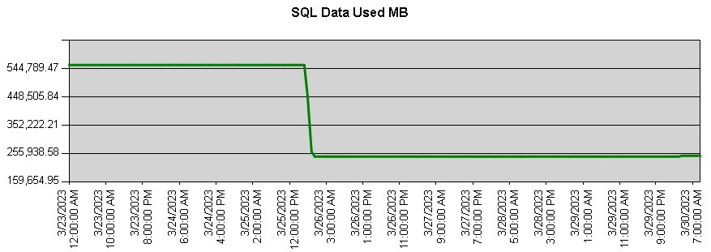
What is Data Compression?
We Are What’s Next.
SQL Data Compression is a powerful feature in SQL Server designed to reduce the storage footprint of your data with databases while enhancing overall performance.
Benefits of data compression:
Reduced Storage Requirements
Improve I/O Performance
Improved Memory Utilization
After compression
Before
compression
Real client example
Notes:
Host introduce Corey H

Slide 5



History of SQL Data Compression
We Are What’s Next.
2008
2016
2022
Data compression available in
all Editions
as of SQL 2016 SP1
Introduces XML Compression as new
feature on Columns and Indexes in SQL 2022
Started as a SQL Enterprise
feature in SQL 2008

Slide 6
Types of Data Compression
We Are What’s Next.
Row Compression
2. Page Compression
3. Compress/Decompress Functions
4. XML Compression
Notes:
Host introduce Corey H

Slide 7
Row and Page Data Compression
We Are What’s Next.
Row Compression
Stored fixed-length data types like CHAR, NCHAR, and BINARY are stored as variable-length data type by not storing blank spaces
Benefits:
Moderate space savings on disk (could be 20% - 40% savings)
Low CPU overhead
Automatically applied to new data or changed data
Transparent to users and applications
Example:
Char(20) – if only using 5 characters, will convert to varchar(5) and strip out the blank characters
Page Compression
Applies Row Compression
Applies prefix compression (storing repeated prefix values once per page)
Implements dictionary compression (replacing repeated values with pointers)
Benefits:
Higher space savings
Reduces number of I/O operations
Automatically applied to new data or changed data
Transparent to users and applications
Example:
Values abcd1234, abcd456, and abcd789 will store abcd as a prefix and reference it for each value.
Notes:
Host introduce Corey H

Slide 8
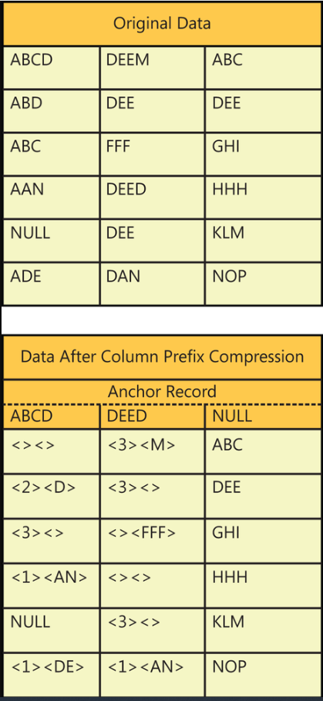
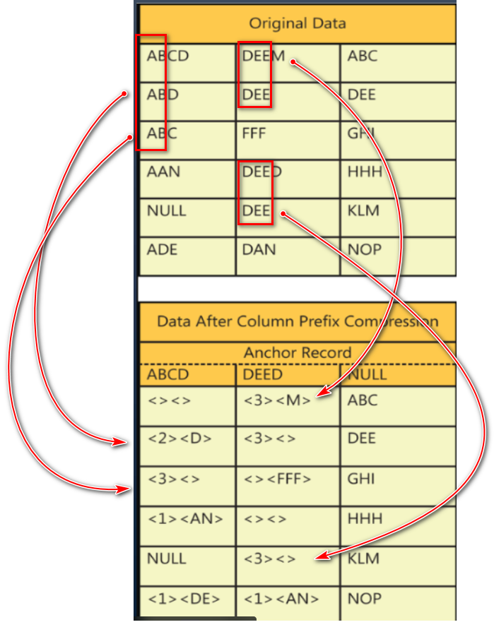
We Are What’s Next.
Prefix Compression
Notes:
Host introduce Corey H

Slide 9
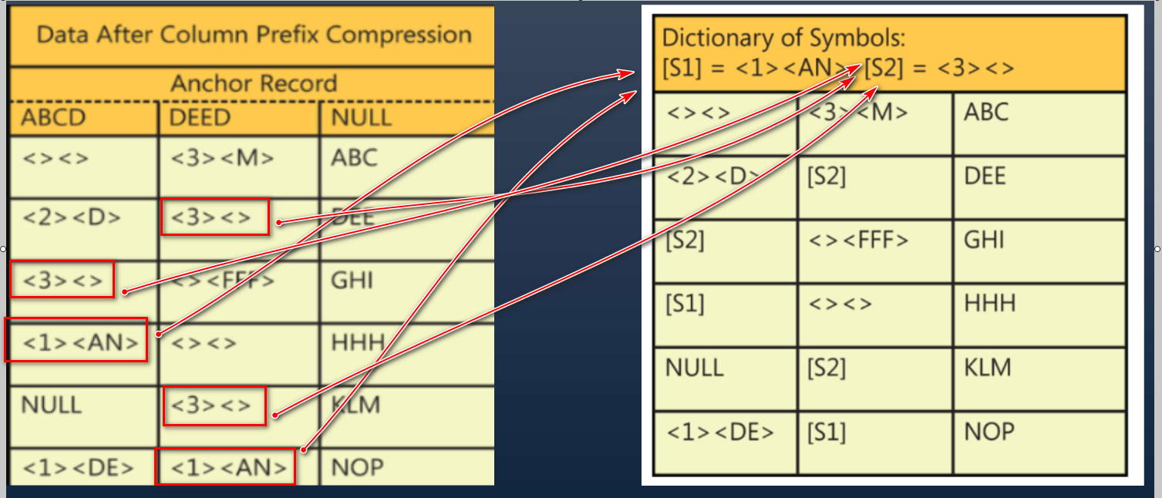
We Are What’s Next.
Dictionary Compression
Notes:
Host introduce Corey H

Slide 10
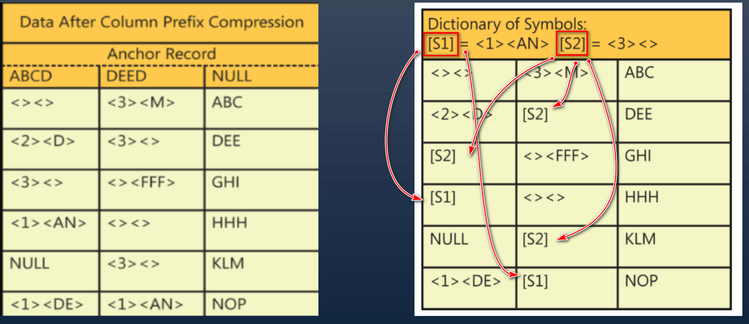
We Are What’s Next.
Dictionary Compression
Notes:
Host introduce Corey H

Slide 11
Syntax and Application
We Are What’s Next.
CREATE TABLE NAME (…........) WITH (DATA_COMPRESSION = NONE | ROW | PAGE)
ALTER TABLE NAME REBUILD WITH (DATA_COMPRESSION = NONE | ROW | PAGE)
CREATE INDEX NAME …....... WITH (DATA_COMPRESSION = NONE | ROW | PAGE)
ALTER INDEX NAME …........ REBUILD WITH (DATA_COMPRESSION = NONE | ROW | PAGE)
What can data compression be applied to?
Whole Heap Table
Clustered Index Table
Non-clustered Index
Indexed view
Partitioned Table and Indexes
Can be applied anytime you build or rebuild
Can only use ONLINE Option with SQL Enterprise, Azure SQLDB or Azure MIs

Slide 12
Pros vs. Cons of Data Compression
We Are What’s Next.
Pros
Storage Savings: 20-60% reduction in database size
I/O Performance: Fewer disk operations, faster queries
Buffer Efficiency: More data fits in memory cache
Backup Benefits: Smaller, faster backups
Transparent: No application code changes needed
Cons
CPU Overhead: increased processor usage
Workload Limitations: Less ideal for write-heavy systems
Implementation Downtime: Required for initial compression
Maintenance Needs: Occasional rebuilds for optimal compression
Edition Restrictions: Some features limited by SQL Server edition

Slide 13
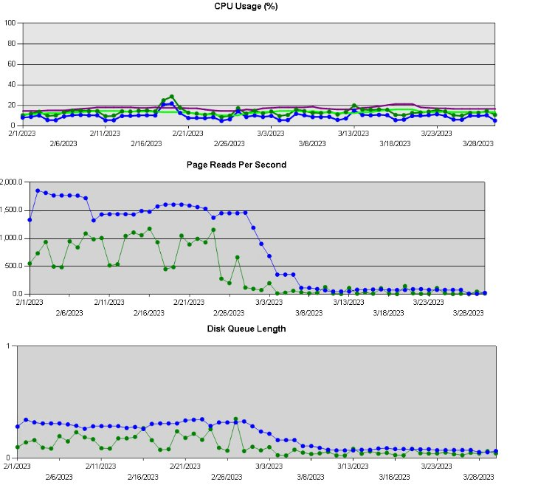
Real-life Examples of Data Compression

Slide 14
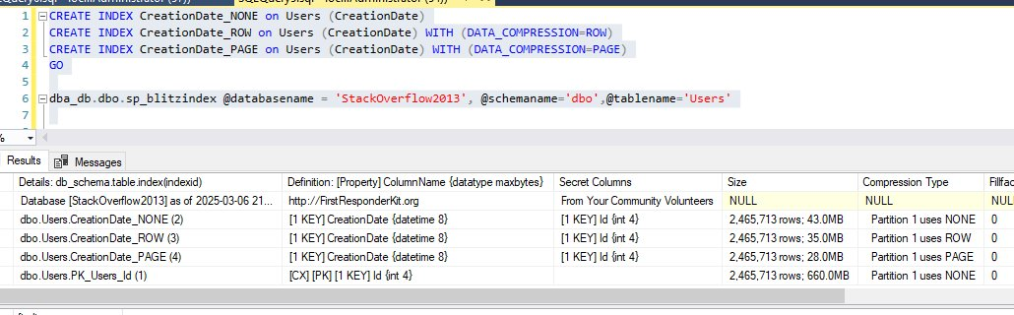
Stackoverflow Users Table

Slide 15
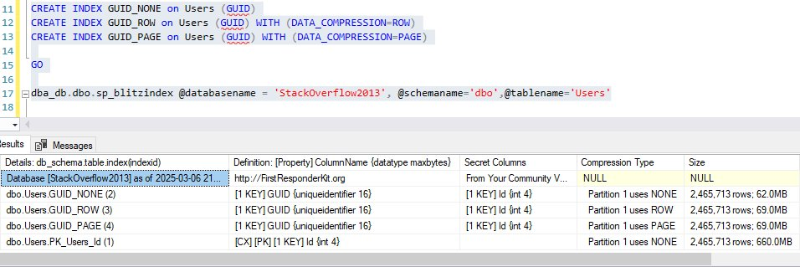
Stackoverflow Users Table

Slide 16
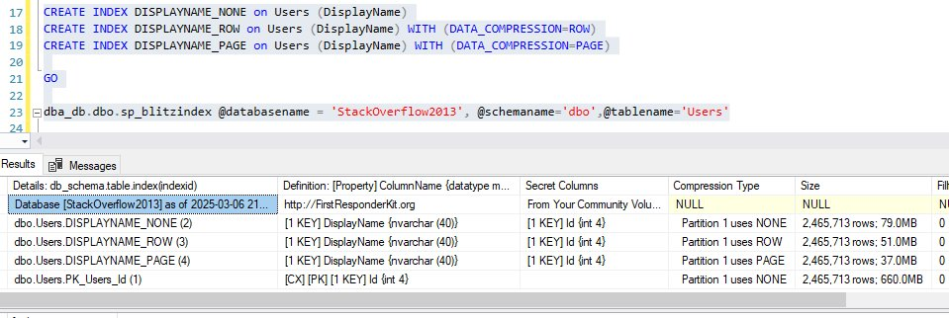
Stackoverflow Users Table

Slide 17
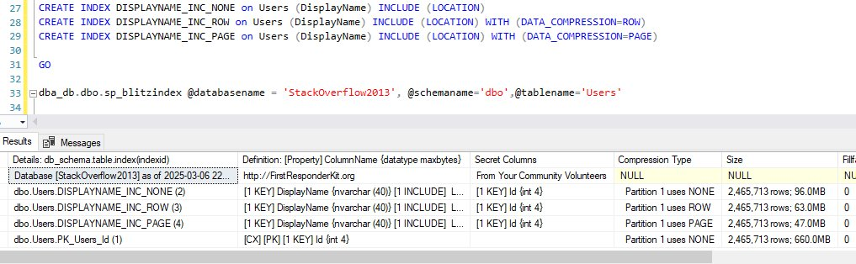
Stackoverflow Users Table

Slide 18
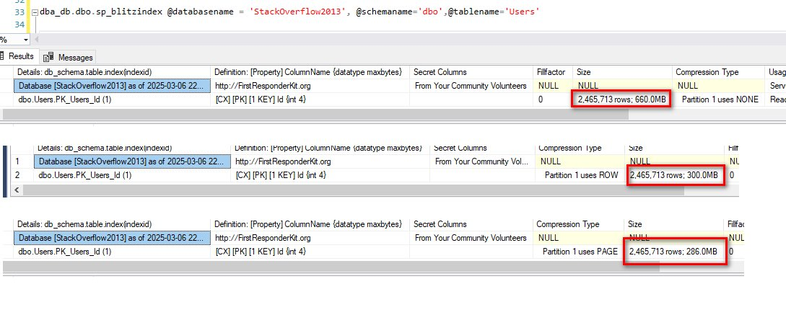
Stackoverflow Users Table

Slide 19
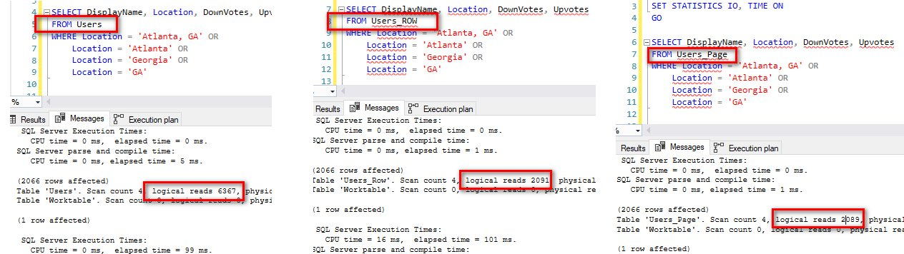
Stackoverflow Users Table

Slide 20
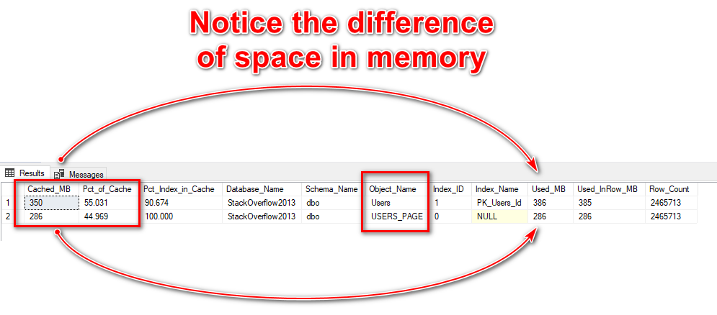
Closer Look @ Buffer Pool

Slide 21
Compress / Decompress Functions
We Are What’s Next.
This function compresses the data into varbinary (max) data type.
You must invoke this function for each data section to compress.
It uses the Gzip algorithm
Purpose: It reduces the storage size of large strings or binary data.
Syntax: COMPRESS(expression)
The expression can be varchar, nvarchar, char, nchar, or varbinary.
Companion function: DECOMPRESS() is used to restore the compressed data to its original form.
Notes:
Host introduce Corey H

Slide 22
Function Syntax
We Are What’s Next.
COMPRESS(expression)
Example:
INSERT INTO Documents (DocumentID, CompressedContent) VALUES (1, COMPRESS('This is a sample document text that will be compressed before storage'));
DECOMPRESS(expression)
Example:
SELECT _id, name, surname, datemodified, CAST(DECOMPRESS(info) AS NVARCHAR(MAX)) AS info FROM player;
Notes:
Host introduce Corey H

Slide 23
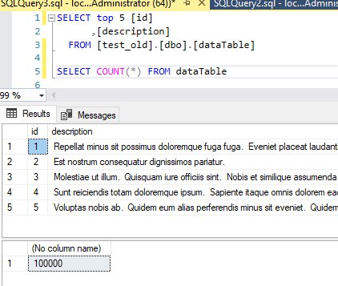
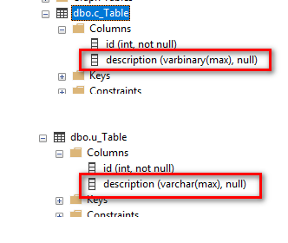
Sample (100000 Rows)

Slide 24
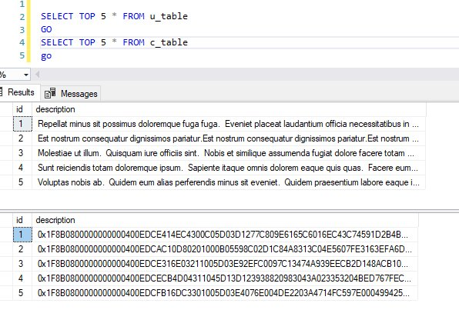
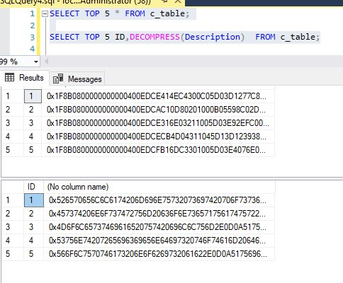
How to Create a New Uncompressed Table (Cont.)
Look at the raw data
Decompress Data

Slide 25
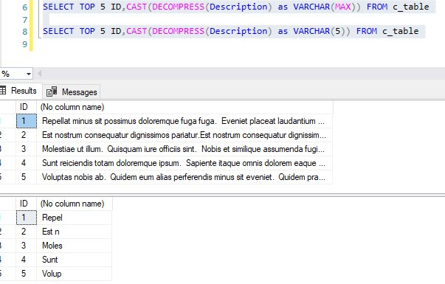
Convert/Cast with Decompress

Slide 26
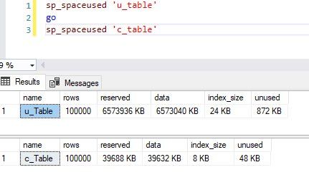
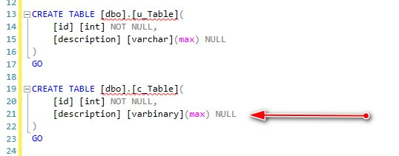
Comparison Results
View space used for both tables
Remember data type using Compress()
6.27 GB
.038 GB

Slide 27
XML Compression
Applies to: SQL Server 2022 (16.x) and later versions, Azure SQL Database, and Azure SQL Managed Instance.
You can apply XML Compression on a column and you can apply on XML Indexes.
Syntax for Primary XML Clustered Index
CREATE PRIMARY XML INDEX PXML_ProductModel_CatalogDescription
ON Production.ProductModel (CatalogDescription)
WITH (XML_COMPRESSION = ON);
Create a table that uses XML compression
CREATE TABLE dbo.T1(
c1 INT,
c2 XML)
WITH (XML_COMPRESSION = ON);

Slide 28
Resources and Tools for Compression
We Are What’s Next.
Sp_estimate_data_compression_savings
EXEC sp_estimate_data_compression_savings @schema_name = 'Sales',
@object_name = 'OrderDetails',
@index_id = NULL, -- NULL = all indexes, or specify a particular index ID
@partition_number = NULL, -- NULL = all partitions, or specify a partition number
@data_compression = 'ROW'; -- Compression type to estimate (ROW, PAGE, or COLUMNSTORE)
DBATools
Test-dbadbcompression
Get-dbadbcompression
Set-dbadbcompression
Ultimate Compression Script:
(https://eitanblumin.com/2020/02/18/ultimate-compression-savings-estimation-script-entire-database/)

Slide 29
Should I use Row or Page Compression?
How do you know to apply row or page compression?
It is based on the following two metrics:
U: The percentage of update operations on a specific table, index, or partition, relative to total operations on that object.
The lower the value of U (that is, the table, index, or partition is infrequently updated), the better candidate it is for page compression.
S: The percentage of scan operations on a table, index, or partition, relative to total operations on that object.
The higher the value of S (that is, the table, index, or partition is mostly scanned), the better candidate it is for page compression.

Slide 30
Row or Page Compression?
U:
/*To compute U, use the statistics in the DMV sys.dm_db_index_operational_stats. U is the ratio (expressed in percent) of updates performed on a table or index to the sum of all operations (scans + DMLs + lookups) on that table or index. The following query reports U for each table and index in the database
The following query reports U for each table and index in the database.
*/ SELECT o.name AS [Table_Name], x.name AS [Index_Name], i.partition_number AS [Partition], i.index_id AS [Index_ID], x.type_desc AS [Index_Type], i.leaf_update_count * 100.0 / (i.range_scan_count + i.leaf_insert_count + i.leaf_delete_count + i.leaf_update_count + i.leaf_page_merge_count + i.singleton_lookup_count ) AS [Percent_Update] FROM sys.dm_db_index_operational_stats (db_id(), NULL, NULL, NULL) I JOIN sys.objects o ON o.object_id = i.object_id JOIN sys.indexes x ON x.object_id = i.object_id AND x.index_id = i.index_id WHERE (i.range_scan_count + i.leaf_insert_count + i.leaf_delete_count + leaf_update_count + i.leaf_page_merge_count + i.singleton_lookup_count) != 0 AND objectproperty(i.object_id,'IsUserTable') = 1 ORDER BY [Percent_Update] ASC
S:
/*To compute S, use the statistics in the DMV sys.dm_db_index_operational_stats. S is the ratio (expressed in percent) of scans performed on a table or index to the sum of all operations (scans + DMLs + lookups) on that table or index. In other words, S represents how heavily the table or index is scanned.
The following query reports S for each table, index, and partition in the database.
*/ SELECT o.name AS [Table_Name], x.name AS [Index_Name], i.partition_number AS [Partition], i.index_id AS [Index_ID], x.type_desc AS [Index_Type], i.range_scan_count * 100.0 / (i.range_scan_count + i.leaf_insert_count + i.leaf_delete_count + i.leaf_update_count + i.leaf_page_merge_count + i.singleton_lookup_count ) AS [Percent_Scan] FROM sys.dm_db_index_operational_stats (db_id(), NULL, NULL, NULL) I JOIN sys.objects o ON o.object_id = i.object_id JOIN sys.indexes x ON x.object_id = i.object_id AND x.index_id = i.index_id WHERE (i.range_scan_count + i.leaf_insert_count + i.leaf_delete_count + leaf_update_count + i.leaf_page_merge_count + i.singleton_lookup_count) != 0 AND objectproperty(i.object_id,'IsUserTable') = 1 ORDER BY [Percent_Scan] DESC

Slide 31
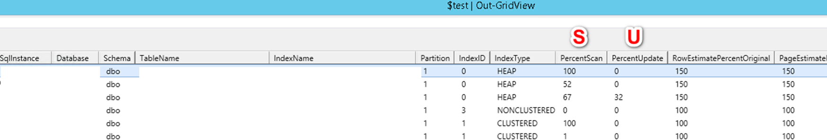
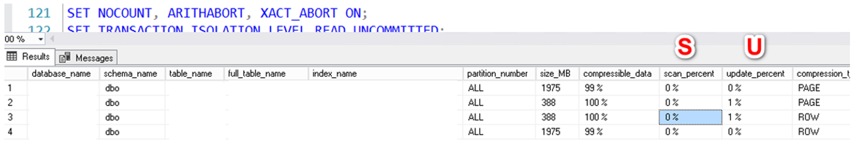
Use Tools
We Are What’s Next.
DBATools – Test-DbaDBCompression example
Ultimate Compression Script

Slide 32
Row or Page Compression?
We Are What’s Next.
Use Row Compression if you're looking for simple savings with low CPU impact.
Use Page Compression for maximum savings with slightly higher CPU cost.
Best Practices and Implementation Tips
Test with tools first for assessment
Analyze workload and potential benefits
Start with row compression before page compression
Implement selectively rather than database-wide
Maintain compressed tables
Consider compression during maintenance windows
Review space savings in non-prod first
Balance I/O and CPU considerations and Monitor
Adjust hardware if needed
Test, Test, Test

Slide 33
Test Pattern to Find Results
We Are What’s Next.
1.Took 1 table from database and copied to a test database/server
2. Made 3 copies of table
One with no compress
One with row compression
One with page compression
3. Ran series of test queries (could do stored proc)
Set Statistics IO and Time On.
Also DBCC FreeProcCache every time
4. Copy information from messages tab and use https://statisticsparser.com/ to summarize data and put into spreadsheet
5. Also look at query plan and capture estimated subtree if desired
6. Avg your findings
7. Plot into charts to show visual gains and benefits

Slide 34
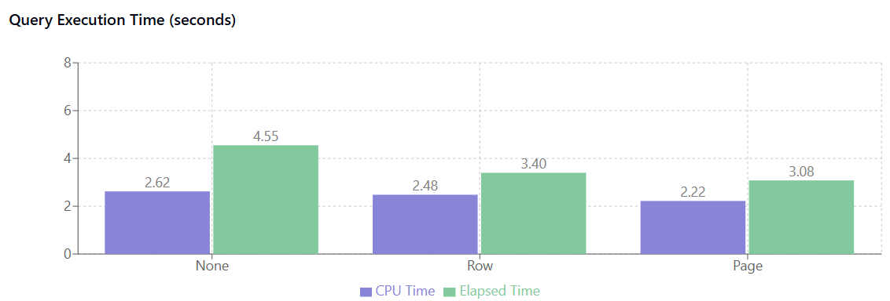
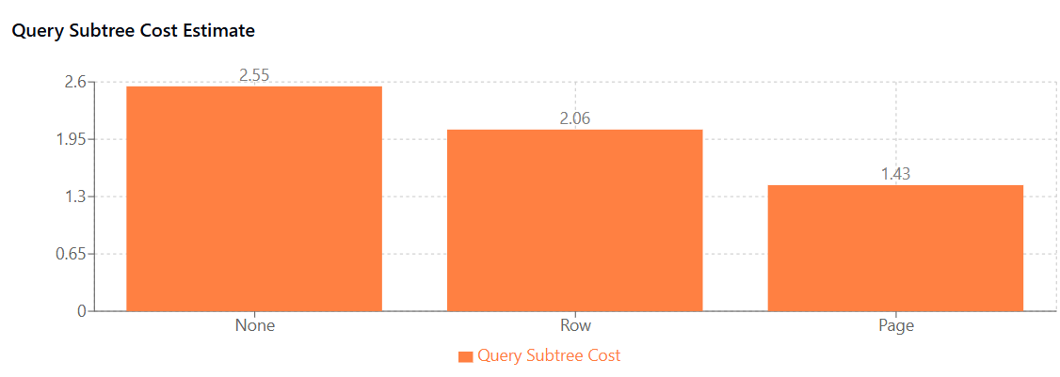
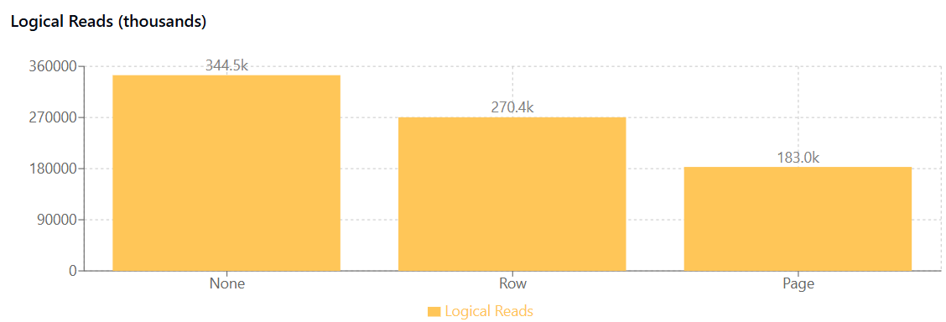
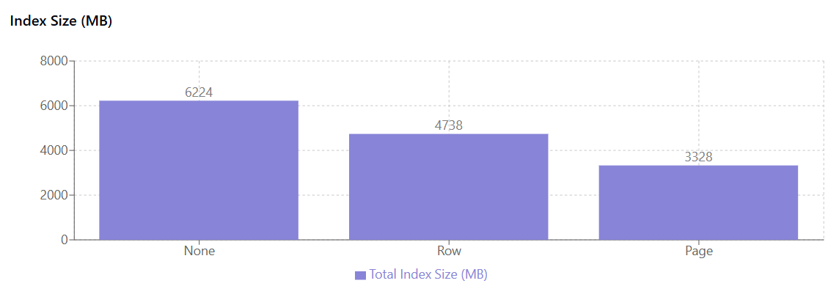
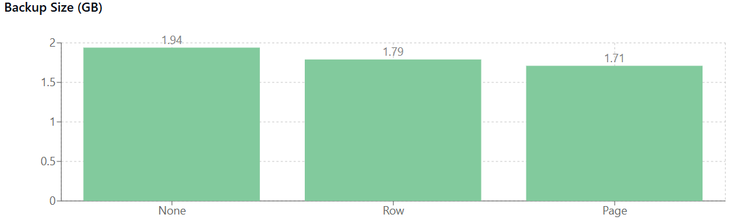
Test Pattern Results Examples
We Are What’s Next.

Slide 35
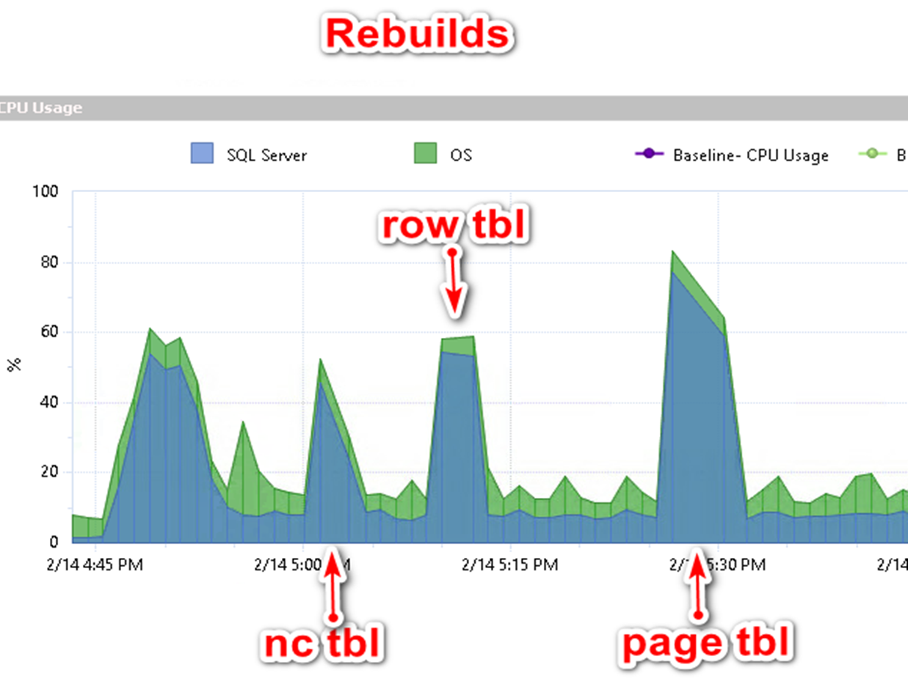
Test Pattern Results Examples
We Are What’s Next.

Slide 36
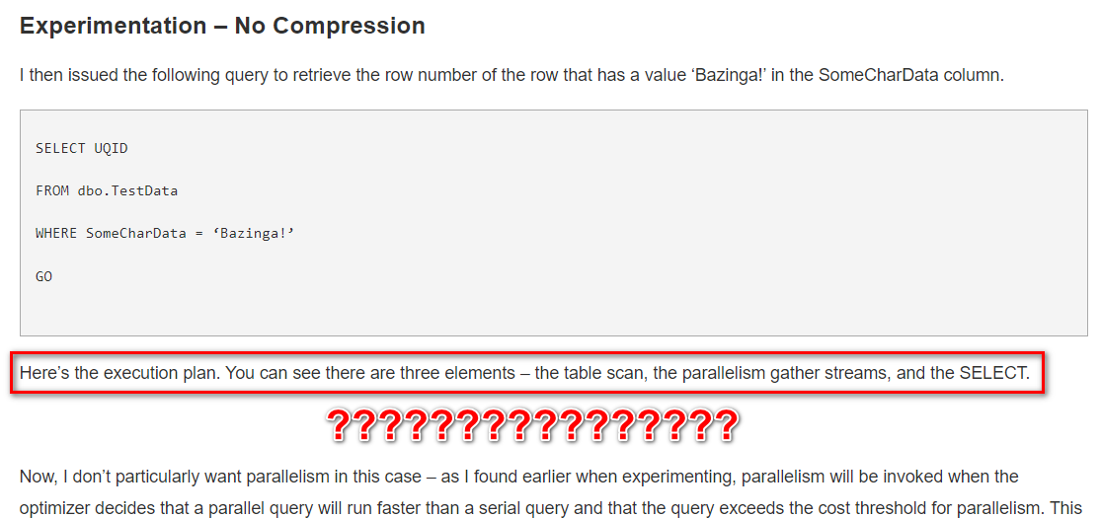
Test Pattern Source
We Are What’s Next.
https://www.mssqltips.com/sqlservertip/3187/demonstrating-the-effects-of-using-data-compression-in-sql-server/

Slide 37

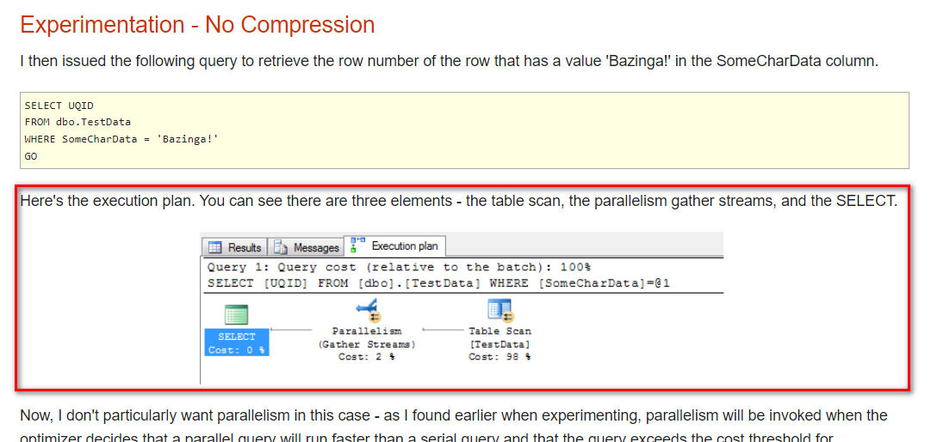
Test Pattern Source – Find original
We Are What’s Next.
Go to http://archive.org

Slide 38
Time for Q & A
We Are What’s Next.

